Slide 1
Stay Fit
Alex Garbalyauskas
22440482
BSc (Honours) in Computing
Final Year Project

Slide 2

Main Idea
Stay-Fit is designed to make fitness motivation simple, social, and consistent.
Inspired by the spontaneity of BeReal, the app encourages users to stay active by posting short daily workout clips.
Users receive a daily notification prompting them to record a 30–60 second workout video.
The video is posted to a shared fitness feed, creating accountability, motivation, and community support.
Focuses on real, everyday fitness, not polished or edited content.

Slide 3

Problem Addressed
Many fitness apps focus only on exercise tracking and do not encourage community engagement. Users need a platform that supports both fitness goals and social interaction in one system.
Many people are inactive/unhealthy.
Some fitness apps are complex & expensive.
Users struggle to stay consistent & motivated.
A fun way to stay active with friends.

Slide 4
Who is it for?
Stay Fit is designed for people who want to stay active and manage their fitness goals.
It is suitable for users who want both workout tracking and social interaction in one platform.
The system is aimed at fitness enthusiasts, students, and anyone looking for motivation and support in maintaining a healthy lifestyle.

Slide 5
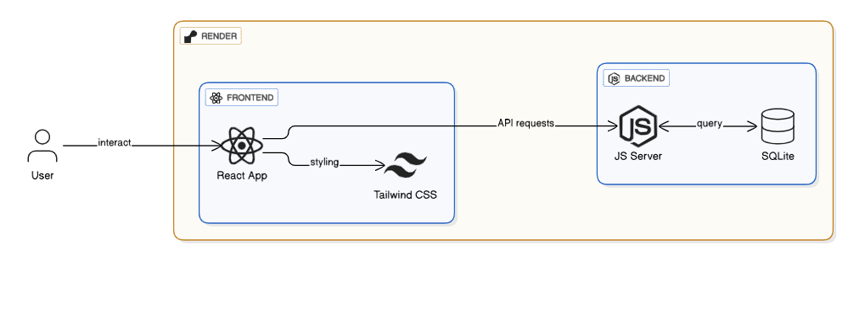
Technical Stack
The project was built using a frontend, backend, and database architecture. It also uses external services for email verification and social login.

Slide 6
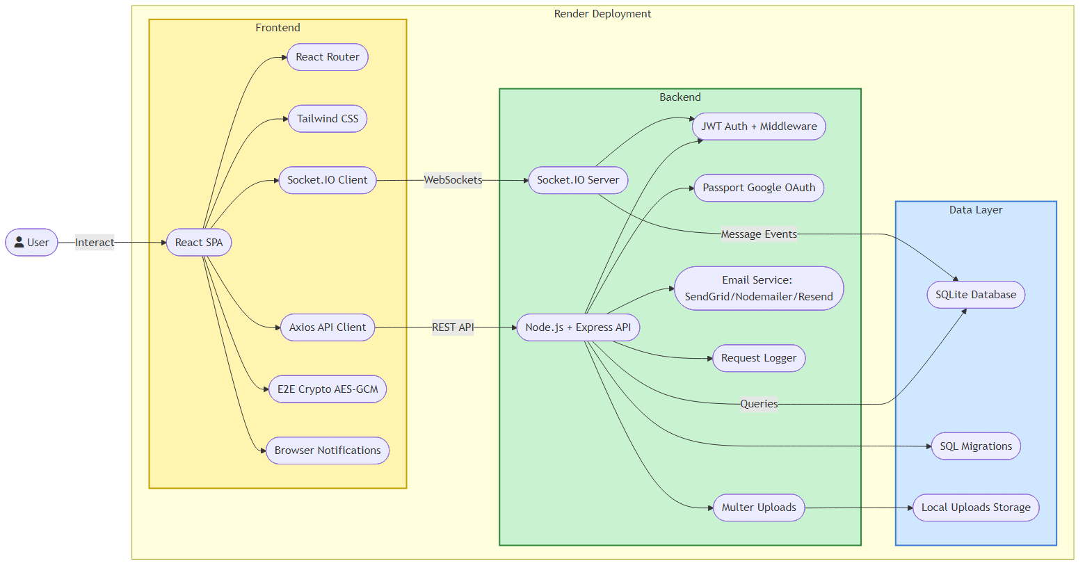

Slide 7


Main Features
Authentication: Google OAuth
Social Interaction: Web Chat (Socket.IO) , GIFs, Emojis, Comments
AI Chat Helper: User to ai chat (OpenAI)
Workout Planner: Create and manage workout via calendar
Exercise Tutorials and Map: Access exercise tutorials and location-based fitness support
Friend Requests: Send, accept, and manage friend requests
Notifications: For friend, post, workout plan
Settings Management System: Language, Sound, Rate, About, Details

Slide 8

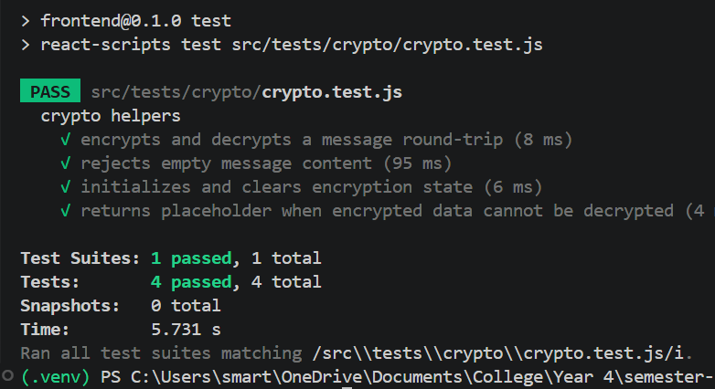
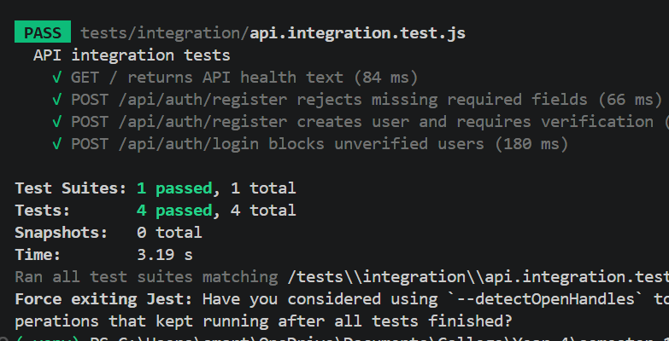
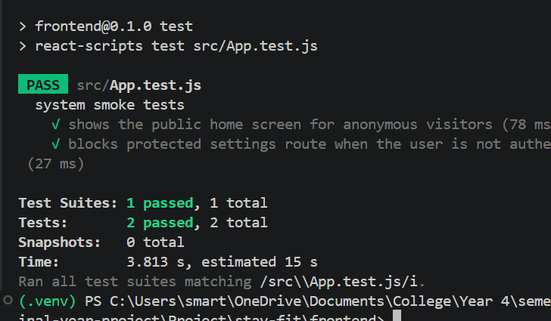
Testing
The application was tested using Jest to check that the main functions worked correctly.
Unit testing with Jest
Integration testing for API routes
System testing for overall app flow
Class testing for authentication cases

Slide 9

Future Ideas / Prospects
Expand to native mobile apps (iOS/Android) for easier access.
Create monetization (sponsored workouts, fitness coach profiles).
Integrate wearables (Fitbit, Apple Watch, Strava) for automatic health data sync.

Slide 10

Demo and Access QR
https://stay-fit-2.onrender.com/

